Slide 1
CMCS POE PART3
Name: Kiara Israel ST10277747

Slide 2
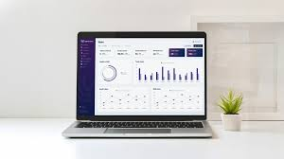


What Tools I used
ASP.NET MVC Web Application (With models and controllers as well as views)
SQL –SSMS
Entity Framework

Slide 3
What is the purpose of CMCS
The purpose of CMCS (Claims Management & Control System) is to make life easier and manage the entire claims process within an organization. It allows users (e.g., Lecturers, admin users - Programme Coordinators and Academic Managers, and the super user HR) to:
Submit claims: Lecturers can submit claims for reimbursement based on hours worked and hourly rates, along with necessary supporting documents.
Verify and approve claims: Programme Coordinators and Academic Managers verify and approve the submitted claims, ensuring that they meet organizational standards and criteria.
HR Management: HR handles the administrative side by managing user accounts, adding new users, and updating user information.
Report Generation: HR can generate detailed reports and invoices for claims, allowing the organization to process payments efficiently.
Security and Role Management: The system ensures that only authorized roles (HR, Programme Coordinators, Academic Managers, and Lecturers) have access to the relevant functionalities based on their role.
CMCS ensures a smooth, automated process for claims submission, verification, and management, with clear accountability and tracking for all involved parties. The system's primary goal is to enhance efficiency, reduce manual errors, and improve overall claim processing within an organization.

Slide 4
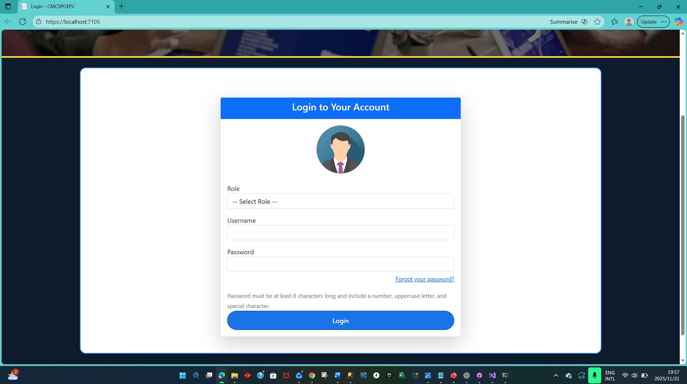
Login Page (Username and Role Selection)
This page allows users to log in by selecting their role (e.g., HR, Lecturer, Programme Coordinator) and providing their username and password. It ensures that users enter the correct login credentials before being directed to their respective dashboard. The role-based logic on this page allows for role-specific access to functionalities (HR, Lecturer, Programme Coordinator).

Slide 5
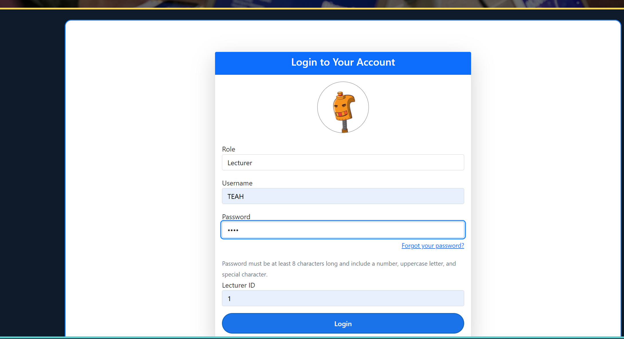
Lecturer Login with Lecturer ID
After entering the username and password, the Lecturer is prompted to enter their unique Lecturer ID. This ID is essential for distinguishing claims submitted by individual lecturers, as it is tied to their account and will be used for claim submission and management. This step ensures that each lecturer can only access and submit their own claims.

Slide 6
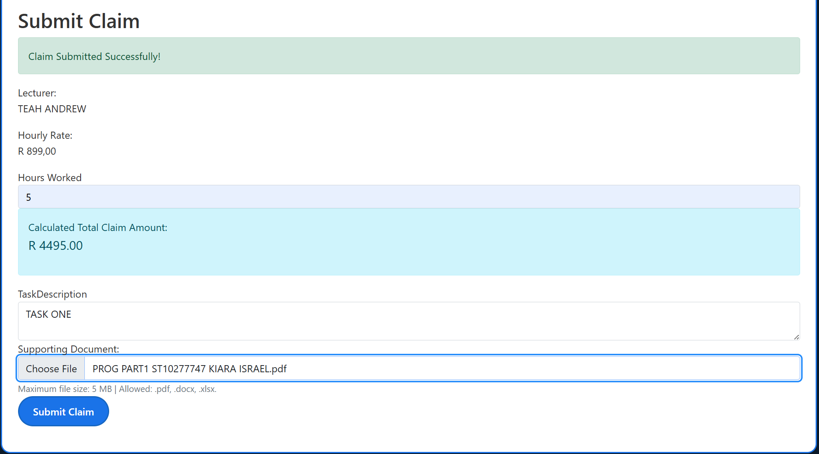
Submit Claim Form
The Lecturer submits a claim by providing the number of hours worked, their hourly rate, and any task-related documents. Upon submission, the form calculates the total claim amount based on the hours worked and hourly rate. This must be automated. This page is used for claim submission, where lecturers can also upload supporting documents (e.g., PDFs).

Slide 7
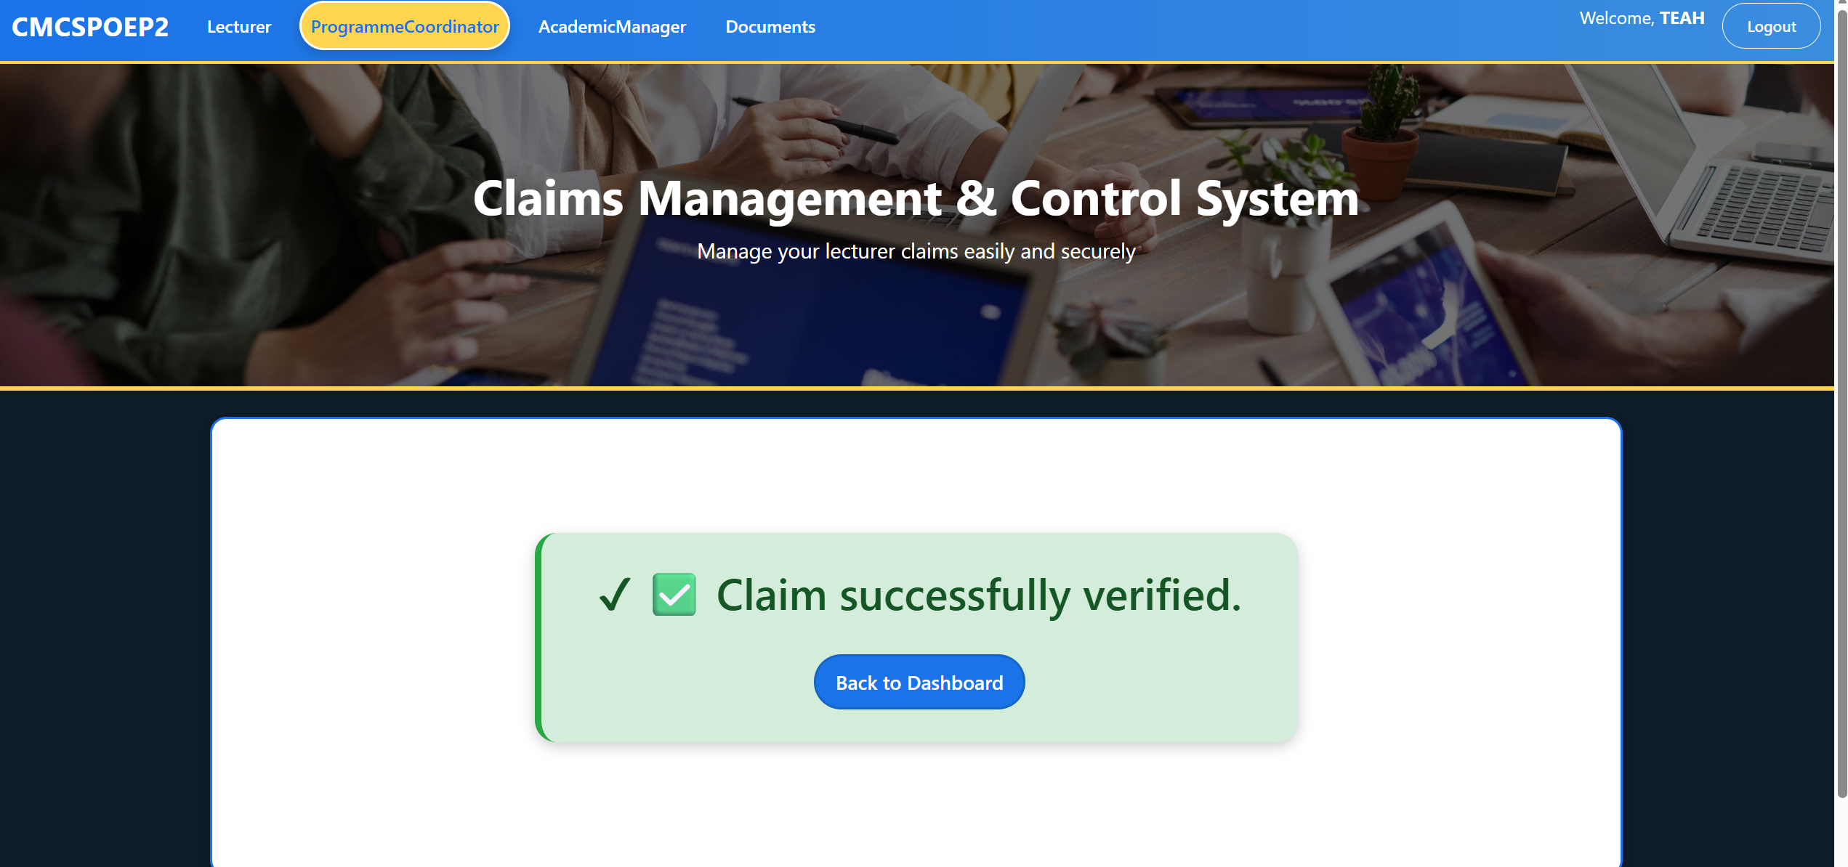
Claim Successfully Verified by Programme Coordinator
After submitting a claim, the Programme Coordinator can verify and approve it. This screen confirms that the claim has been successfully verified and updates its status. The claim then proceeds to the next stage (HR approval or payment processing). The Programme Coordinator also has the ability to approve or reject claims.
This will approve the Processed Claim and finally go straight to the reports folder on the HR’s Side

Slide 8
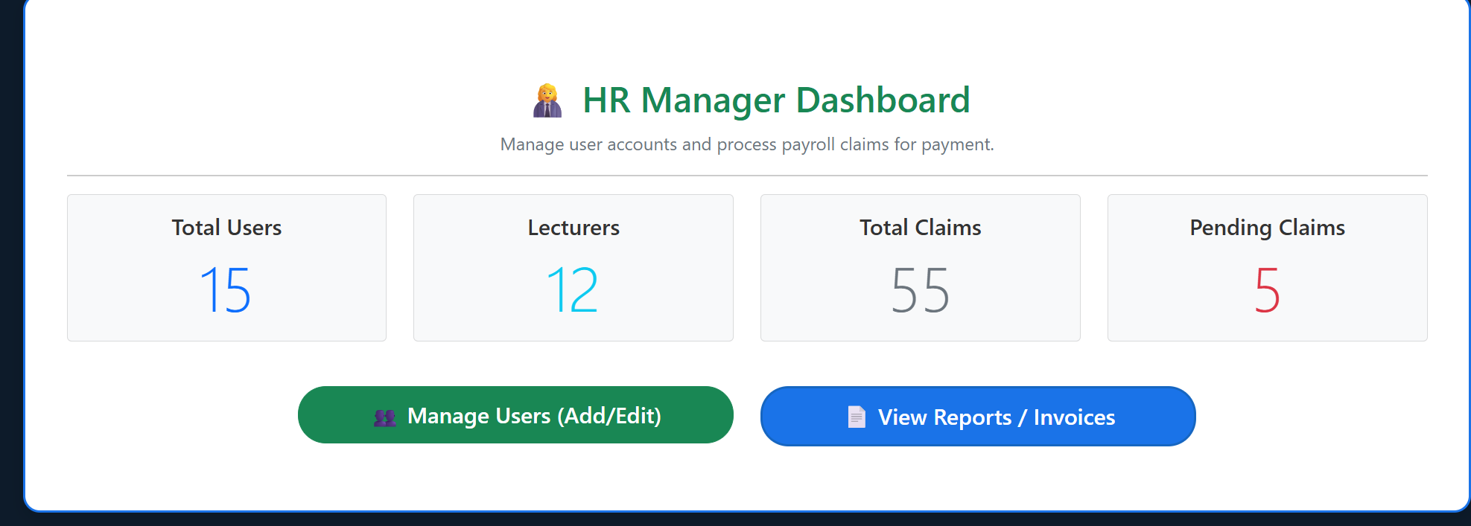
HR Dashboard - Processed Claims
The HR Dashboard is used to manage and track processed claims. The HR role has access to all claims that are either approved or pending for payment. HR personnel can download a processed claims report (in PDF or text format) and perform other administrative tasks, including updating user profiles and adding new users to the system. HR users are shown a dashboard summary with claim information such as claim amounts, dates, and status.

Slide 9
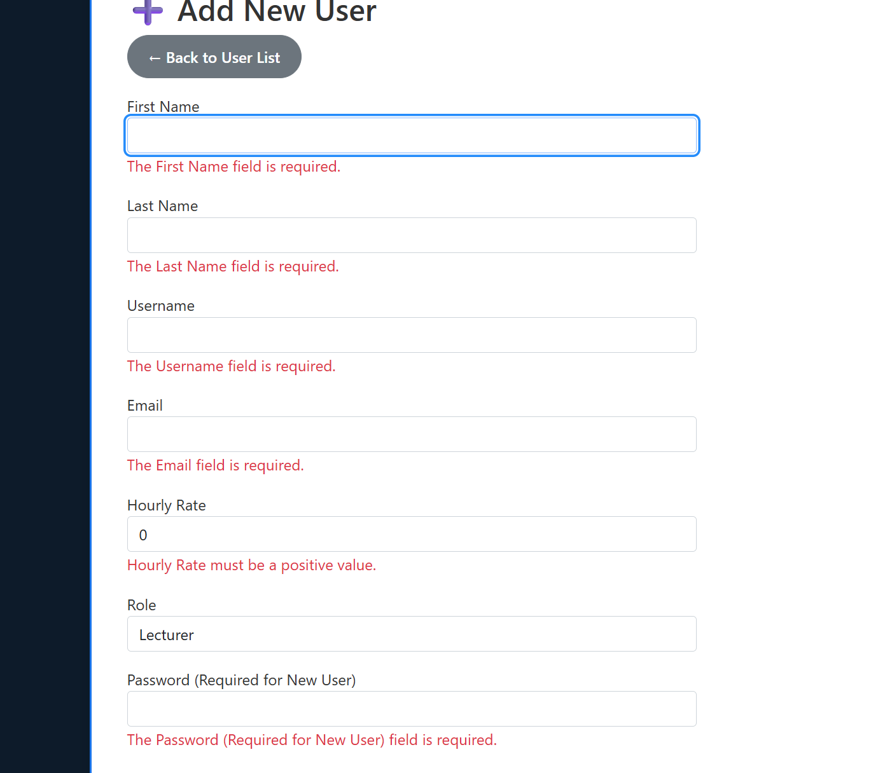
HR Manage User Page
This page allows the HR personnel to create, update, and manage users. HR can add new users by filling in essential details such as first name, last name, username, email, hourly rate, role, and password. HR has full access to modify user information and roles, ensuring that only authorized personnel can be assigned to specific roles within the system (Lecturer, Programme Coordinator, Academic Manager).
This is the error handling; this shows the HR that the rows must be filled perfectly

Slide 10
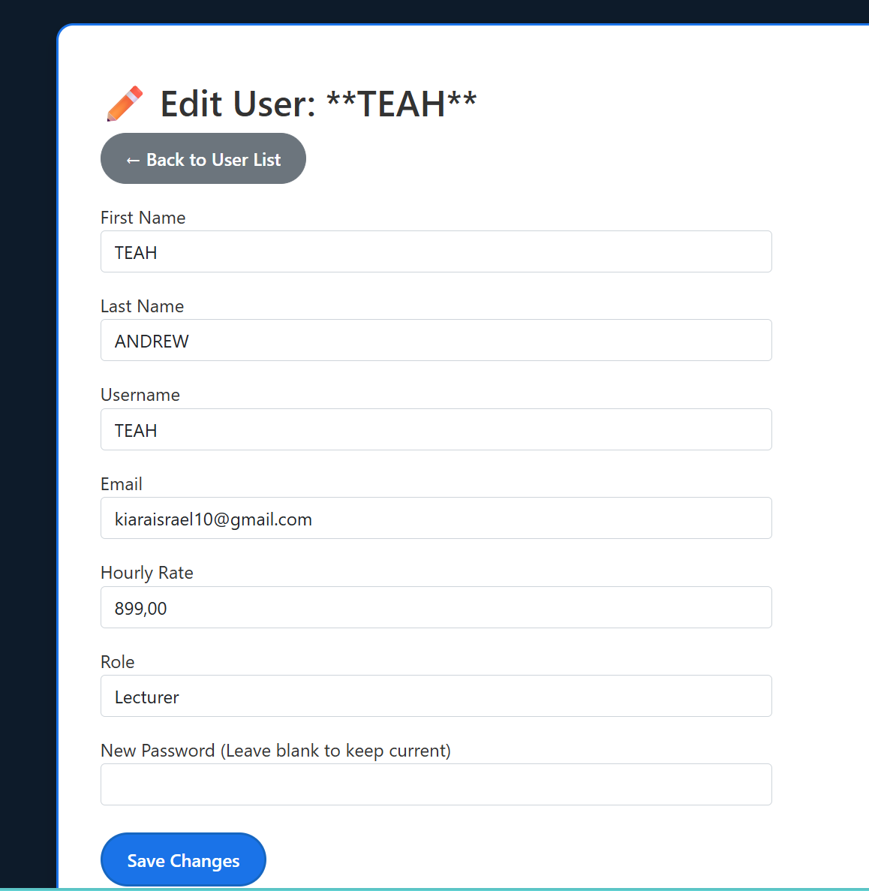
HR Edit User Information
HR can edit existing user details such as name, email, username, hourly rate, and role. This page is part of the user management system, and HR can also reset or update passwords for users as needed.

Slide 11
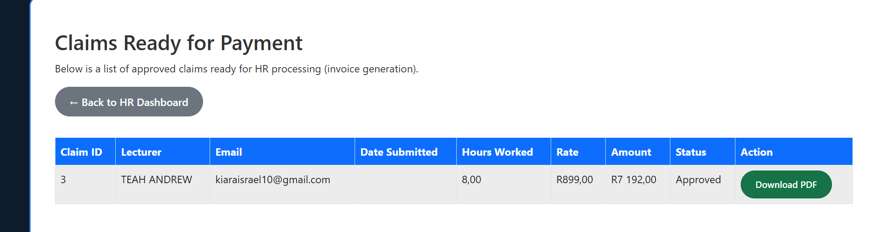
Claims Ready for Payment (HR View)
This screen shows claims that are ready for payment. HR is responsible for generating invoices for claims marked as "Approved." HR can download the invoice as a PDF, making this the final step before claims are processed for payment. This functionality allows for streamlined and accurate processing of claims for payment based on their status.
This is the button that will allow the HR to download the Invoice statement and view it

Slide 12

Thank you for your time and attention.

